Slide 1
Manson Middle School

Slide 2
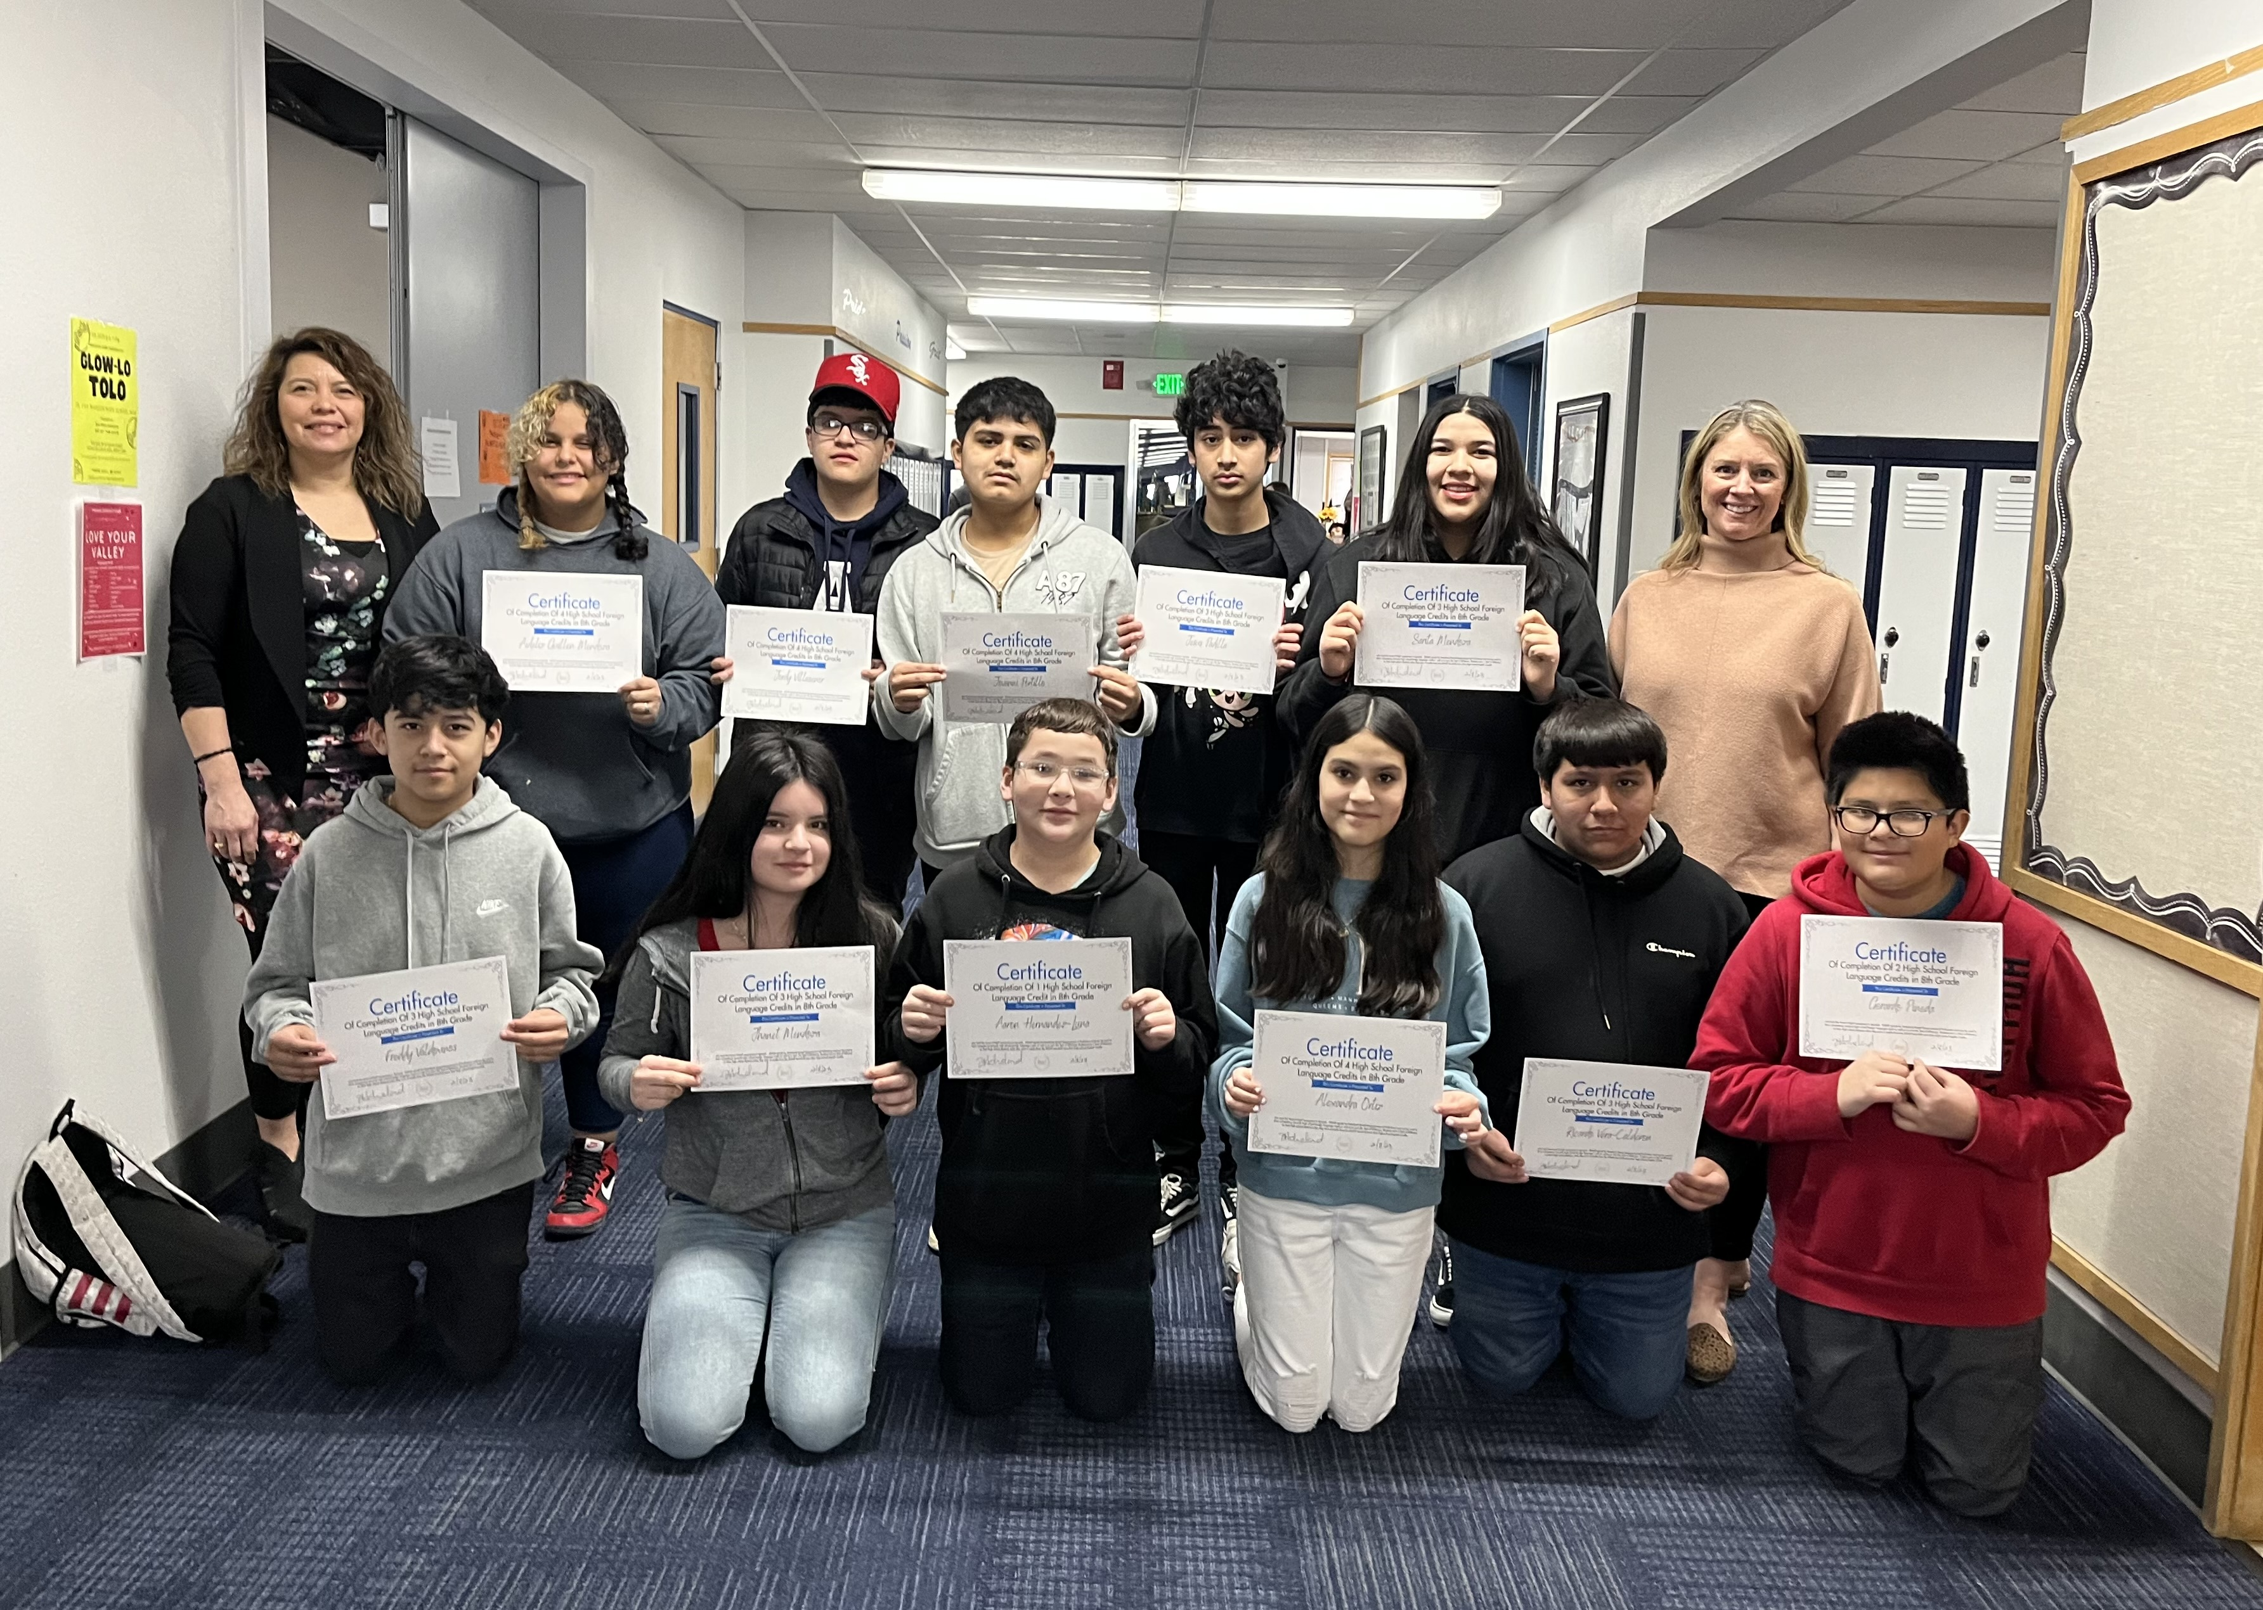
HS Foreign Language Credit

Slide 3
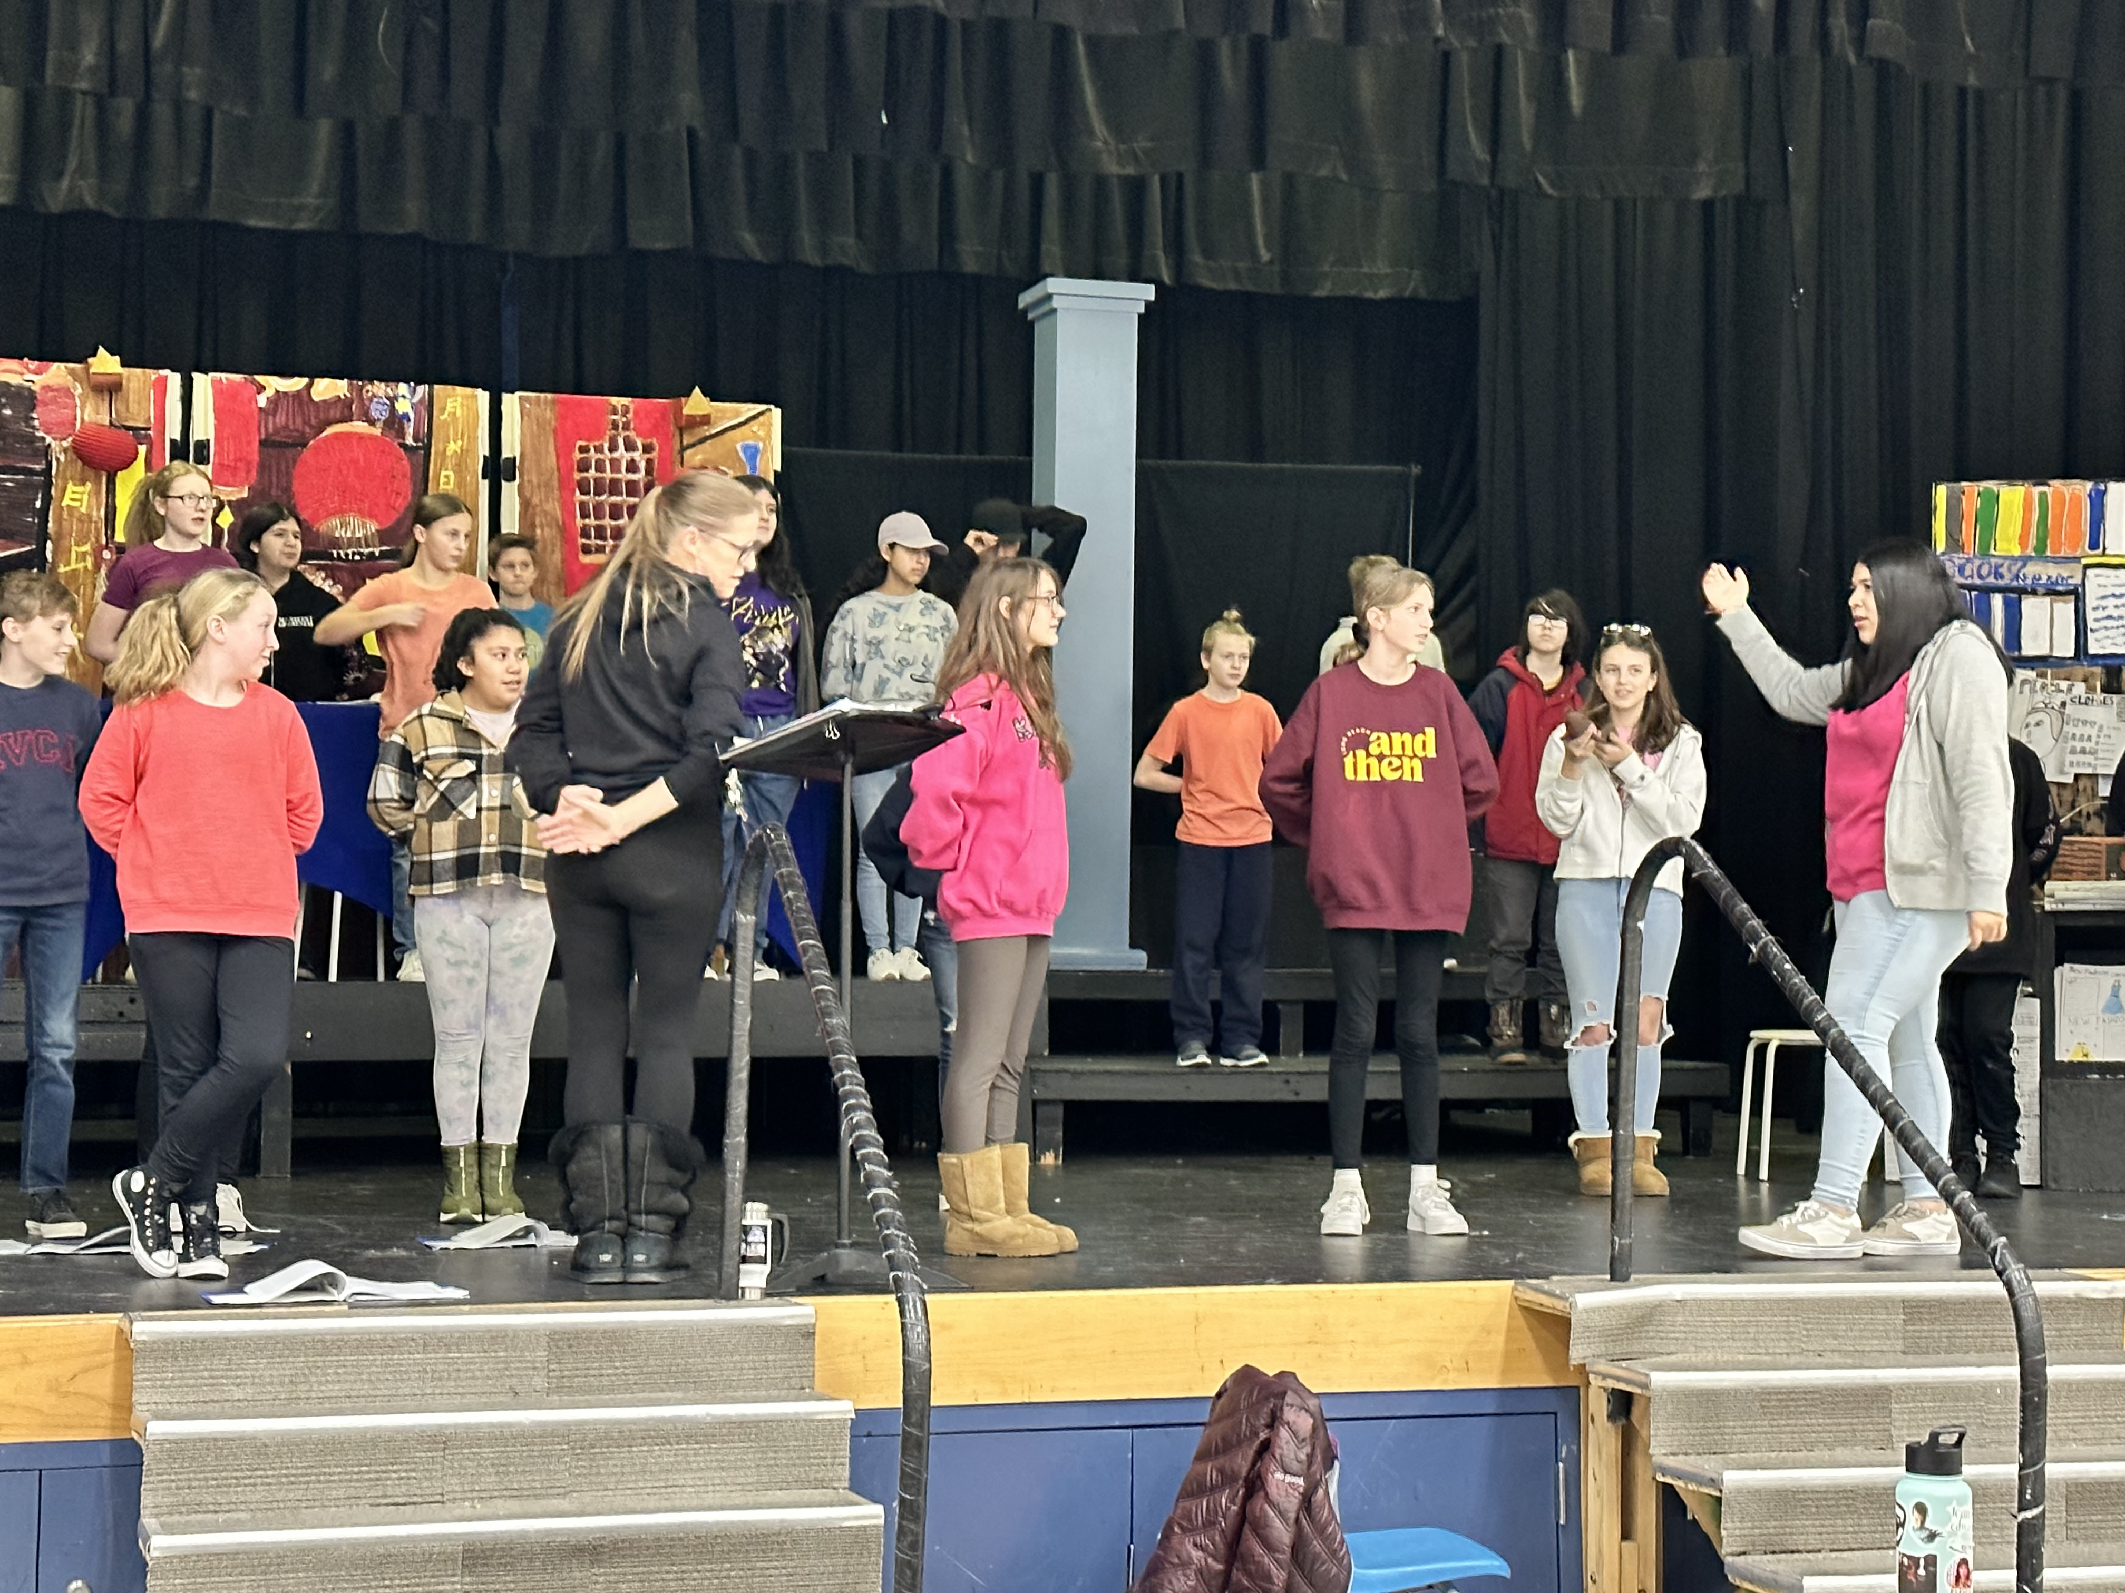
A Cricket in Time Square

Slide 4
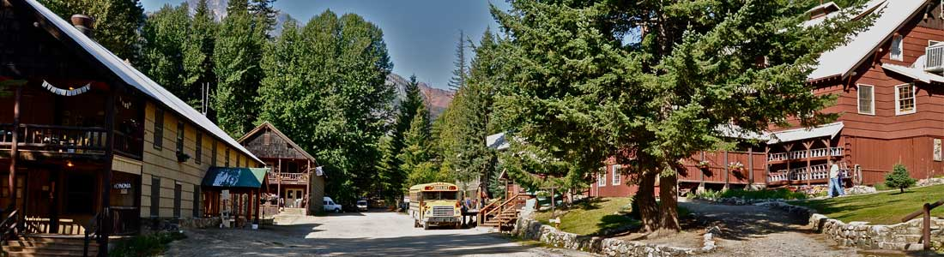
Outdoor Schools:
We are going to HOLDEN ☺

Slide 5
Two-Way Communication:
TalkingPoints
Over 1,000 messages sent (MMS)
“Thank you. I’ve never received messages like this from (my child’s) teachers”
In the last week:
  Classroom information
  Busses running late
  Phone system not working in the buildings
  Immunization updates
  Homework and assignment updates
  Concerns and celebrations

